Slide 1
Object Oriented Programing with Java
Stefan Stefanov
BE Developer / Dev Lead

Slide 2
Agenda
What OOP is?
Pros and cons
How a Java class looks like
Four principles of OOP
Some specific type of classes

Slide 3
What OOP is?
Object-oriented programming (OOP) is a programming paradigm based on the concept of "objects", which can contain data and code:
data in the form of fields
code in the form of methods

Slide 4
Pros and Cons?
Pros:
Productivity of software development increased
Software maintenance improved
Quicker improvement
Cost of development lowered
Good quality software
Cons:
Steep expectation to learn and adapt
Bigger program size
Not appropriate for a wide range of issues

Slide 5
How a Java class looks like
Fields a.k.a Properties
Methods a.k.a Procedures
Constructors
Access modifiers
Some key words

Slide 6
Encapsulation
Idea of bundling data and methods that work on that data within one unit (like a class in Java).
This concept is also often used to hide the internal representation, or state of an object from the outside. This is called information hiding.

Slide 7
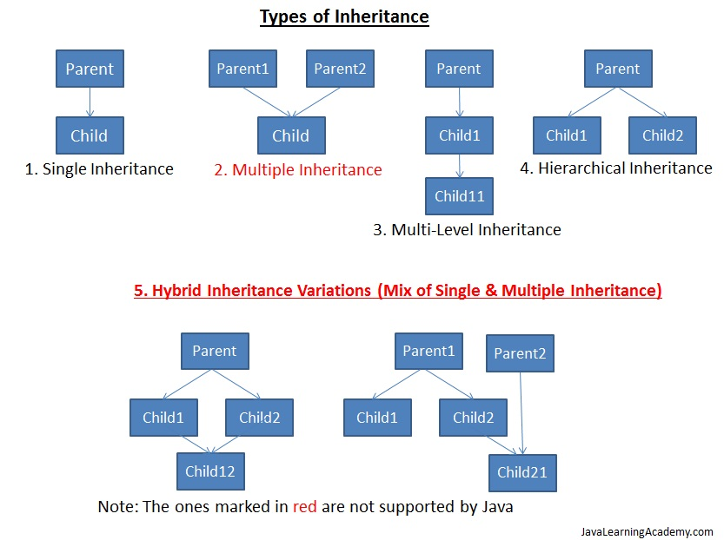
Inheritance
Mechanism where you can to derive a class from another class for a hierarchy of classes that share a set of attributes and methods.

Slide 8
Abstraction
Abstraction is selecting data from a larger pool to show only relevant details of the object to the user.
One of the most important concepts of OOP
It allows you to group related classes as siblings
Reduces the complexity of the design and implementation process of software

Slide 9
Polymorphism
Poly = many: polygon = many-sided
Morph = change or form: Morpheus = the Greek god of dreams able to take any form.
So polymorphism is the ability (in programming) to present the same interface for differing underlying forms (data types).

Slide 10
Specific types of a class
Static a.k.a. Utility Class.
Final Class.
Abstract Class.
Concrete Class.
Singleton Class.
POJO a.k.a Data Class.
Inner Class.

